Slide 1
41183 PRIVACY PRESERVING
Lecture 11. Machine Unlearning

Slide 2
Assignment 2
Due on Friday, 11:59 pm, October 24, 2025
Individual work
You can use the previous topic, but NOT using Assignment 1 content
It is NOT allowed to using AI to complete your assignment
There is NO exam for this subject
Please complete the survey. Thanks.
Students can access the online survey at
www.sfs.uts.edu.au via their mobile devices

Slide 3
Outline
Background of machine unlearning (MU)
Machine unlearning algorithms
Exact unlearning (fast retraining)
Approximate unlearning
Unlearning verification
Privacy and security issues in machine unlearning

Slide 4
Background of Machine Unlearning

Slide 5
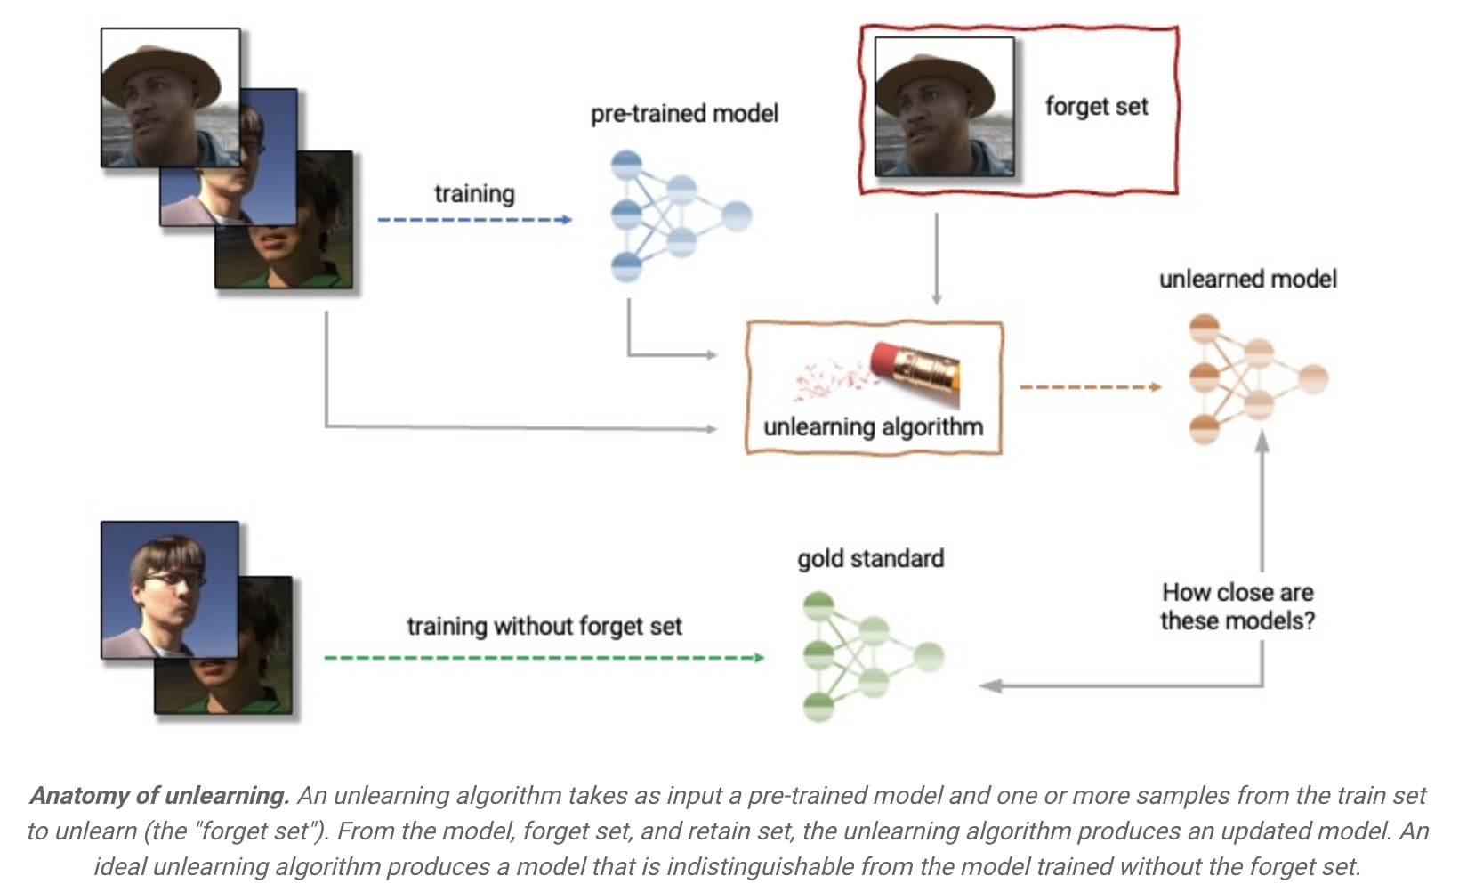
What is machine unlearning?
Remove the trace of user-specified samples from an already-trained ML model

Slide 6
Why need machine unlearning?
People are increasingly concerned about their private information and the corresponding Right to be forgotten was legislated worldwide.
The General Data Protection Regulation (GDPR) in the European Union
The PIPEDA privacy legislation in Canada
The California Consumer Privacy Act (CCPA) in the United States
…
It is easy to remove a data sample from databases, but is hard to remove the contribution of the data samples from an already-trained machine learning model.

Slide 7
Challenges when we design MU algorithms
Stochasticity of training
A huge amount of randomness exists in the training process during machine learning.
Incrementality of training
The training process in machine learning is an incremental procedure.
Catastrophe of unlearning
Implementing unlearning a model usually makes the unlearned model perform worse than the model retrained from scratch and even causes huge utility loss.
MU under Federated Learning setting
Request to unlearn a dataset, but not reveal it to the server.

Slide 8
MU Algorithms

Slide 9
MU algorithms
The aim of machine unlearning is removing the trace of the erased samples from an already-trained model. In other words, we hope the unlearned model is equivalent to retrained model based on the remaining dataset by removing the erased data.
There are two main kinds solutions:
Exact unlearning (fast retraining)
Approximate unlearning

Slide 10
Exact unlearning (fast retraining)
Exact unlearning must ensure the unlearned model never ‘see’ the erased data. One simple implementation is retraining from scratch, called naïve retraining.
Studies on exact unlearning aim to improve the unlearning efficiency and reduce the computation and storage costs.
One representative example is SISA (Sharded, Isolated, Sliced, and Aggregated training), which split the whole dataset into sub-datasets and train sub-models based on the split subsets, so that when the unlearning requirements occurs, the model server only need to retrain the corresponding sub-model.
* Training or retraining is very expensive

Slide 11
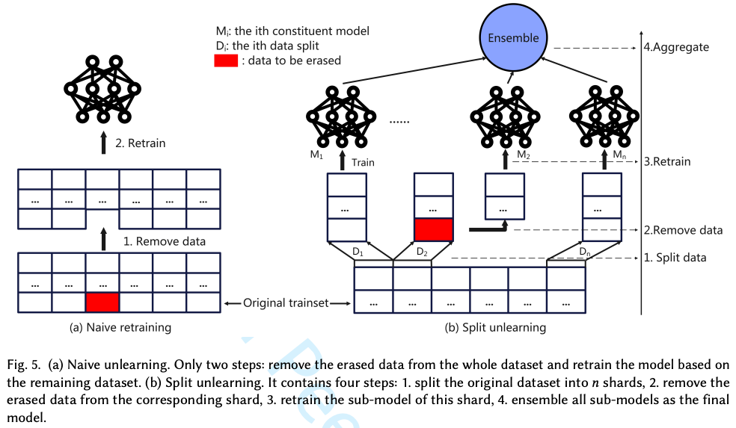
From naïve retraining to fast retraining
One of the representative example is SISA

Slide 12
Approximate unlearning
Approximate unlearning aims to unlearn the already-trained model approximate to the naïve-retrained model, using only the erased data to reduce the computation cost.
There are two representative approximate unlearning methods:
Certified Data Removal (Hessian matrix-based unlearning)
Variational Bayesian Unlearning

Slide 13
Hessian matrix-based unlearning
Hessian matrix-based certified removal methods usually aim to unlearn a model indistinguishable from the naïve-retrained model, through Newton Update.
The Hessian matrix recorded all training steps, MU just involves the related parts.
Advantages:
Since the ɛ-indistinguishable updating derived from differential privacy, these methods are easy to understand.
The Newton Update based on Hessian matrix ensures to optimize with few steps.
Disadvantages:
Hessian matrix is calculated based on the whole remaining dataset. To calculate it is computational.

Slide 14
Variational Bayesian unlearning
Variational Bayesian unlearning tries to unlearn a posterior approximate to the naïve-retrained posterior.
Advantages:
Since these methods are expanded from variational Bayesian inference, the correctness is guaranteed.
Since these methods are only trained based on the erased samples, the efficiency is guaranteed.
Disadvantages:
Exact Bayesian unlearned model is non-trivial, the variational approximating methods are easy to cause catastrophic unlearning.

Slide 15
Unlearning Caused Problems

Slide 16
MU introduced problems
As a user, how do I know that my unlearning request is served.
From economic perspective
- how does the service provider execute unlearning requests
- how to charge unlearning services
…

Slide 17
Effectiveness of MU
Though there many unlearning methods, how to give a verification to the unlearning user to show that the server has unlearned the data from the trained model is difficult.
It is difficult to evaluate the contribution of a sample to the model and to prove the model update is based on the sample as most ML models are agnostic.
Use membership inference attack to test the effectiveness
Add the features in user datasets to setup backdoors

Slide 18
Privacy and security issues in machine unlearning

Slide 19
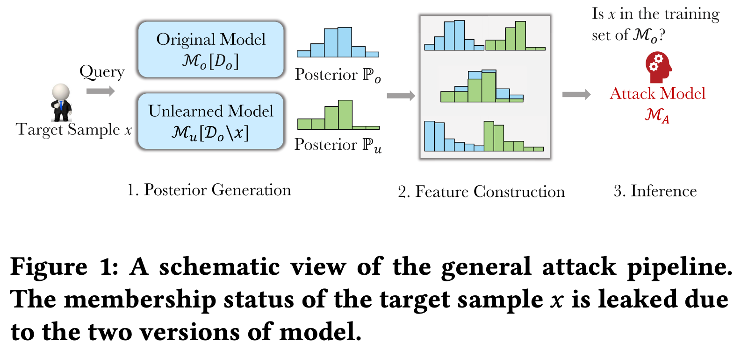
Machine unlearning jeopardize privacy
Adversary can utilize the difference between original already-trained model and the unlearned model to infer the privacy of unlearned samples

Slide 20
MU for other purpose
Machine unlearning can be used to correct models
Machine unlearning can also be used to update existing models
…

